Slide 1

CLASS 8 CD-404 Data Reduction and Data Transformation UNIT 2
Data Reduction and Data Transformation
Prof. Vineeta Shrivastava
Assistant Professor
Department of Computer Science & Engineering
LNCT-E, Bhopal
Lakshmi Narain College of Technology Excellence, Bhopal

Slide 2
CLASS 8 CD-404 Data Reduction and Data Transformation UNIT 2
AGENDA
Data Preprocessing: An Overview
Data Quality
Major Tasks in Data Preprocessing
Data Cleaning
Data Integration
Data Reduction
Data Transformation and Data Discretization
Prof. Vineeta Shrivastava
Assistant Professor
Department of Computer Science & Engineering
LNCT-E, Bhopal
Lakshmi Narain College of Technology Excellence, Bhopal

Slide 3
CLASS 8 CD-404 Data Reduction and Data Transformation UNIT 2
Data Reduction
Prof. Vineeta Shrivastava
Assistant Professor
Department of Computer Science & Engineering
LNCT-E, Bhopal
Lakshmi Narain College of Technology Excellence, Bhopal

Slide 4
CLASS 8 CD-404 Data Reduction and Data Transformation UNIT 2
AGENDA
Data Reduction
What is Data Reduction?
Why it is Important?
Techniques for Data Reduction
Benefits of Data Reduction
Prof. Vineeta Shrivastava
Assistant Professor
Department of Computer Science & Engineering
LNCT-E, Bhopal
Lakshmi Narain College of Technology Excellence, Bhopal

Slide 5
CLASS 8 CD-404 Data Reduction and Data Transformation UNIT 2
Data Reduction
Data reduction techniques ensure the integrity of data while reducing the data. Data reduction is a process that reduces the volume of original data and represents it in a much smaller volume.
Data reduction techniques are used to obtain a reduced representation of the dataset that is much smaller in volume by maintaining the integrity of the original data.
By reducing the data, the efficiency of the data analysis process is improved, which produces the same analytical results.
Prof. Vineeta Shrivastava
Assistant Professor
Department of Computer Science & Engineering
LNCT-E, Bhopal
Lakshmi Narain College of Technology Excellence, Bhopal

Slide 6
CLASS 8 CD-404 Data Reduction and Data Transformation UNIT 2
Importance of Data Reduction
Data reduction aims to define it more compactly. When the data size is smaller, it is simpler to apply sophisticated and computationally high-priced algorithms.
The reduction of the data may be in terms of the number of rows (records) or terms of the number of columns (dimensions).
Prof. Vineeta Shrivastava
Assistant Professor
Department of Computer Science & Engineering
LNCT-E, Bhopal
Lakshmi Narain College of Technology Excellence, Bhopal

Slide 7
CLASS 8 CD-404 Data Reduction and Data Transformation UNIT 2
Techniques of Data Reduction
Dimensionality Reduction
Numerosity Reduction
Data Cube Aggregation
Data Compression
Prof. Vineeta Shrivastava
Assistant Professor
Department of Computer Science & Engineering
LNCT-E, Bhopal
Lakshmi Narain College of Technology Excellence, Bhopal

Slide 8
CLASS 8 CD-404 Data Reduction and Data Transformation UNIT 2
1. Dimensionality Reduction
Dimensionality reduction eliminates the attributes from the data set under consideration, thereby reducing the volume of original data.
It reduces data size as it eliminates outdated or redundant features.
It is the process of reducing the number of attributes or random variables under consideration.
Prof. Vineeta Shrivastava
Assistant Professor
Department of Computer Science & Engineering
LNCT-E, Bhopal
Lakshmi Narain College of Technology Excellence, Bhopal

Slide 9
CLASS 8 CD-404 Data Reduction and Data Transformation UNIT 2
What is Dimensionality Reduction?
The number of input features, variables, or columns present in a given dataset is known as dimensionality, and the process to reduce these features is called dimensionality reduction.
Prof. Vineeta Shrivastava
Assistant Professor
Department of Computer Science & Engineering
LNCT-E, Bhopal
Lakshmi Narain College of Technology Excellence, Bhopal

Slide 10
CLASS 8 CD-404 Data Reduction and Data Transformation UNIT 2
Definition
Dimensionality reduction technique can be defined as, "It is a way of converting the higher dimensions dataset into lesser dimensions dataset ensuring that it provides similar information."
These techniques are widely used in machine learning for obtaining a better predictive model while solving the classification and regression problems.
Prof. Vineeta Shrivastava
Assistant Professor
Department of Computer Science & Engineering
LNCT-E, Bhopal
Lakshmi Narain College of Technology Excellence, Bhopal

Slide 11
CLASS 8 CD-404 Data Reduction and Data Transformation UNIT 2
It is commonly used in the fields that deal with high-dimensional data, such as speech recognition, signal processing, bioinformatics, etc.
It can also be used for data visualization, noise reduction, cluster analysis, etc.
Prof. Vineeta Shrivastava
Assistant Professor
Department of Computer Science & Engineering
LNCT-E, Bhopal
Lakshmi Narain College of Technology Excellence, Bhopal

Slide 12
CLASS 8 CD-404 Data Reduction and Data Transformation UNIT 2
A dataset contains a huge number of input features in various cases, which makes the predictive modeling task more complicated.
Because it is very difficult to visualize or make predictions for the training dataset with a high number of features, for such cases, dimensionality reduction techniques are required to use.
Prof. Vineeta Shrivastava
Assistant Professor
Department of Computer Science & Engineering
LNCT-E, Bhopal
Lakshmi Narain College of Technology Excellence, Bhopal

Slide 13
CLASS 8 CD-404 Data Reduction and Data Transformation UNIT 2
Methods of Dimensionality Reduction
Feature Selection
Feature Extraction
Wavelet Transform
Attribute Subset Selection
Prof. Vineeta Shrivastava
Assistant Professor
Department of Computer Science & Engineering
LNCT-E, Bhopal
Lakshmi Narain College of Technology Excellence, Bhopal

Slide 14
CLASS 8 CD-404 Data Reduction and Data Transformation UNIT 2
Dimensionality Reduction
Feature Selection
Filter method
Wrapper method
Embedded method
Feature Extraction
PCA
Factor analysis
Singular value decomposition
Prof. Vineeta Shrivastava
Assistant Professor
Department of Computer Science & Engineering
LNCT-E, Bhopal
Lakshmi Narain College of Technology Excellence, Bhopal

Slide 15
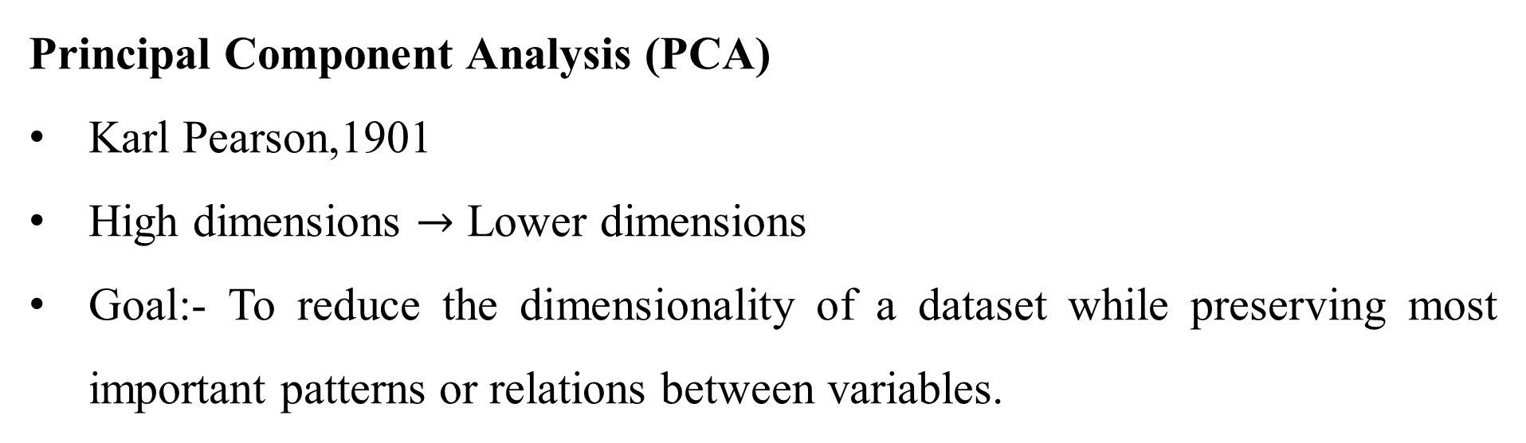
CLASS 8 CD-404 Data Reduction and Data Transformation UNIT 2
Principal Component Analysis (PCA)
Karl Pearson,1901
High dimensions $→$ Lower dimensions
Goal:- To reduce the dimensionality of a dataset while preserving most important patterns or relations between variables.
Prof. Vineeta Shrivastava
Assistant Professor
Department of Computer Science & Engineering
LNCT-E, Bhopal
Lakshmi Narain College of Technology Excellence, Bhopal

Slide 16
CLASS 8 CD-404 Data Reduction and Data Transformation UNIT 2
How Principal Component Analysis (PCA) Works ?
Principal Component Analysis (PCA) is used to reduce the dimensionality of a data set by finding a new set of variables, smaller than the original set of variables, retaining most of the sample’s information, and useful for the regression and classification of data.
Prof. Vineeta Shrivastava
Assistant Professor
Department of Computer Science & Engineering
LNCT-E, Bhopal
Lakshmi Narain College of Technology Excellence, Bhopal

Slide 17
CLASS 8 CD-404 Data Reduction and Data Transformation UNIT 2
Principal Component Analysis (PCA)
Suppose we have a data set to be analyzed that has tuples with n attributes. The principal component analysis identifies k independent features with n attributes that can represent the data set.
In this way, the original data can be converted into a much smaller space, and dimensionality reduction can be achieved.
Principal component analysis can be applied to sparse and skewed data.
Prof. Vineeta Shrivastava
Assistant Professor
Department of Computer Science & Engineering
LNCT-E, Bhopal
Lakshmi Narain College of Technology Excellence, Bhopal

Slide 18
CLASS 8 CD-404 Data Reduction and Data Transformation UNIT 2
Factor Analysis
Technique to reduce a large number of variables into fewer number of factors.
There will not be any outliers in the dataset.
Used to explore interactions between variables.
Singular value decomposition
SVD is like putting on special glasses that help us see the essential patterns in our data more clearly, making it easier to understand and work with.
SVD helps us simplify the data. It finds the most important patterns in the data and focuses on them, ignoring the less important stuff.
Prof. Vineeta Shrivastava
Assistant Professor
Department of Computer Science & Engineering
LNCT-E, Bhopal
Lakshmi Narain College of Technology Excellence, Bhopal

Slide 19
CLASS 8 CD-404 Data Reduction and Data Transformation UNIT 2
Wavelet Transform
In the wavelet transform, suppose a data vector A is transformed into a numerically different data vector A' such that both A and A' vectors are of the same length.
Then how it is useful in reducing data because the data obtained from the wavelet transform can be interrupted.
Wavelet transform can be applied to data cubes, sparse data, or skewed data.
Prof. Vineeta Shrivastava
Assistant Professor
Department of Computer Science & Engineering
LNCT-E, Bhopal
Lakshmi Narain College of Technology Excellence, Bhopal

Slide 20
CLASS 8 CD-404 Data Reduction and Data Transformation UNIT 2
Attribute Subset Selection
The large data set has many attributes, some of which are irrelevant and some are redundant.
The core attribute subset selection reduces the data volume and dimensionality.
The attribute subset selection reduces the volume of data by eliminating redundant and irrelevant attributes.
Prof. Vineeta Shrivastava
Assistant Professor
Department of Computer Science & Engineering
LNCT-E, Bhopal
Lakshmi Narain College of Technology Excellence, Bhopal

Slide 21
CLASS 8 CD-404 Data Reduction and Data Transformation UNIT 2
The attribute subset selection ensures that we get a good subset of original attributes even after eliminating the unwanted attributes.
The resulting probability of data distribution is as close as possible to the original data distribution using all the attributes.
Prof. Vineeta Shrivastava
Assistant Professor
Department of Computer Science & Engineering
LNCT-E, Bhopal
Lakshmi Narain College of Technology Excellence, Bhopal

Slide 22
CLASS 8 CD-404 Data Reduction and Data Transformation UNIT 2
2. Numerosity Reduction
The numerosity reduction reduces the original data volume and represents it in a much smaller form.
It reduces the data volume by chossing alternative smaller forms of data representation.
Types of numerosity reduction
Parametric numerosity reduction.
Non-parametric numerosity reduction.
Prof. Vineeta Shrivastava
Assistant Professor
Department of Computer Science & Engineering
LNCT-E, Bhopal
Lakshmi Narain College of Technology Excellence, Bhopal

Slide 23
CLASS 8 CD-404 Data Reduction and Data Transformation UNIT 2
Parametric: Parametric numerosity reduction incorporates storing only data parameters instead of the original data.
Only parameters of data and outliers are stored instead of actual data.
Regression and Log-Linear
Prof. Vineeta Shrivastava
Assistant Professor
Department of Computer Science & Engineering
LNCT-E, Bhopal
Lakshmi Narain College of Technology Excellence, Bhopal

Slide 24
CLASS 8 CD-404 Data Reduction and Data Transformation UNIT 2
Non-Parametric: A non-parametric numerosity reduction technique does not assume any model.
The non-Parametric technique results in a more uniform reduction, irrespective of data size, but it may not achieve a high volume of data reduction like the parametric.
Histogram
Clustering
Sampling
Prof. Vineeta Shrivastava
Assistant Professor
Department of Computer Science & Engineering
LNCT-E, Bhopal
Lakshmi Narain College of Technology Excellence, Bhopal

Slide 25
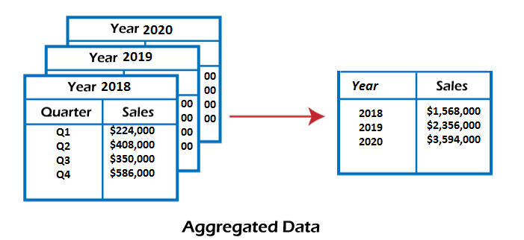
CLASS 8 CD-404 Data Reduction and Data Transformation UNIT 2
Data Cube Aggregation
This technique is used to aggregate data in a simpler form.
Data Cube Aggregation is a multidimensional aggregation that uses aggregation at various levels of a data cube to represent the original data set, thus achieving data reduction.
Prof. Vineeta Shrivastava
Assistant Professor
Department of Computer Science & Engineering
LNCT-E, Bhopal
Lakshmi Narain College of Technology Excellence, Bhopal

Slide 26
CLASS 8 CD-404 Data Reduction and Data Transformation UNIT 2
The data cube aggregation is a multidimensional aggregation that eases multidimensional analysis.
The data cube present precomputed and summarized data which eases the data mining into fast access.
Prof. Vineeta Shrivastava
Assistant Professor
Department of Computer Science & Engineering
LNCT-E, Bhopal
Lakshmi Narain College of Technology Excellence, Bhopal

Slide 27
CLASS 8 CD-404 Data Reduction and Data Transformation UNIT 2
Data Compression
Data compression employs modification, encoding, or converting the structure of data in a way that consumes less space.
Data compression involves building a compact representation of information by removing redundancy and representing data in binary form.
Prof. Vineeta Shrivastava
Assistant Professor
Department of Computer Science & Engineering
LNCT-E, Bhopal
Lakshmi Narain College of Technology Excellence, Bhopal

Slide 28
CLASS 8 CD-404 Data Reduction and Data Transformation UNIT 2
Data that can be restored successfully from its compressed form is called Lossless compression.
In contrast, the opposite where it is not possible to restore the original form from the compressed form is Lossy compression. Dimensionality and numerosity reduction method are also used for data compression.
Prof. Vineeta Shrivastava
Assistant Professor
Department of Computer Science & Engineering
LNCT-E, Bhopal
Lakshmi Narain College of Technology Excellence, Bhopal

Slide 29
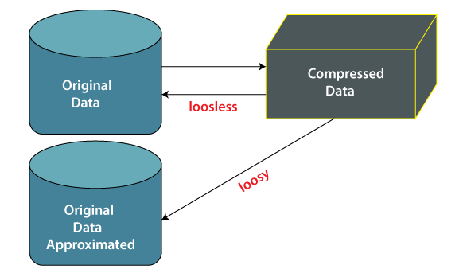
CLASS 8 CD-404 Data Reduction and Data Transformation UNIT 2
Prof. Vineeta Shrivastava
Assistant Professor
Department of Computer Science & Engineering
LNCT-E, Bhopal
Lakshmi Narain College of Technology Excellence, Bhopal

Slide 30
CLASS 8 CD-404 Data Reduction and Data Transformation UNIT 2
Data compression techniques
Lossless Compression
Lossy Compression
Prof. Vineeta Shrivastava
Assistant Professor
Department of Computer Science & Engineering
LNCT-E, Bhopal
Lakshmi Narain College of Technology Excellence, Bhopal

Slide 31
CLASS 8 CD-404 Data Reduction and Data Transformation UNIT 2
Lossless Compression
Encoding techniques (Run Length Encoding) allow a simple and minimal data size reduction.
Lossless data compression uses algorithms to restore the precise original data from the compressed data.
Prof. Vineeta Shrivastava
Assistant Professor
Department of Computer Science & Engineering
LNCT-E, Bhopal
Lakshmi Narain College of Technology Excellence, Bhopal

Slide 32
CLASS 8 CD-404 Data Reduction and Data Transformation UNIT 2
Lossy Compression
In lossy-data compression, the decompressed data may differ from the original data but are useful enough to retrieve information from them.
For example, the JPEG image format is a lossy compression, but we can find the meaning equivalent to the original image.
Methods such as the Discrete Wavelet transform technique PCA (principal component analysis) are examples of this compression.
Prof. Vineeta Shrivastava
Assistant Professor
Department of Computer Science & Engineering
LNCT-E, Bhopal
Lakshmi Narain College of Technology Excellence, Bhopal

Slide 33
CLASS 8 CD-404 Data Reduction and Data Transformation UNIT 2
Benefits of Data Reduction
Data reduction can save energy.
Data reduction can reduce your physical storage costs.
And data reduction can decrease your data center track
Prof. Vineeta Shrivastava
Assistant Professor
Department of Computer Science & Engineering
LNCT-E, Bhopal
Lakshmi Narain College of Technology Excellence, Bhopal

Slide 34
CLASS 8 CD-404 Data Reduction and Data Transformation UNIT 2
THANKYOU
Prof. Vineeta Shrivastava
Assistant Professor
Department of Computer Science & Engineering
LNCT-E, Bhopal
Lakshmi Narain College of Technology Excellence, Bhopal

